Slide 1
8.14 K-th Longest Increasing Sequence
(난이도:중)
조창우

Slide 2
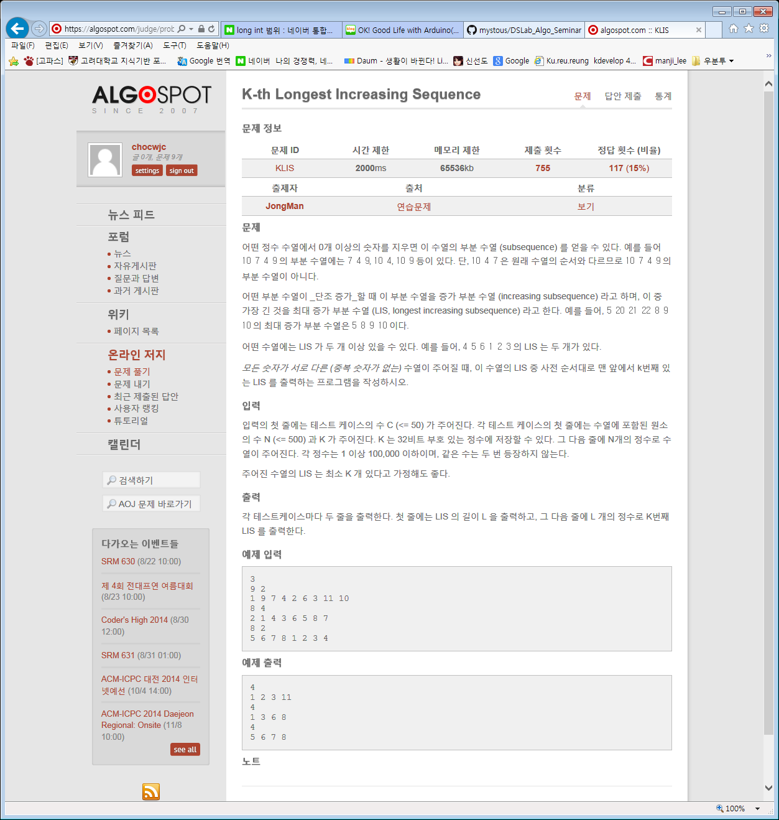
2 1 4 3 6 5 8 7
LIS : 4
1 3 5 7
1 3 5 8
1 3 6 7
1 3 6 8
1 4 5 7
1 4 5 8
1 4 6 7
1 4 6 8
2 3 5 7
2 3 5 8
2 3 6 7
2 3 6 8
2 4 5 7
2 4 5 8
2 4 6 7
2 4 6 8

Slide 4
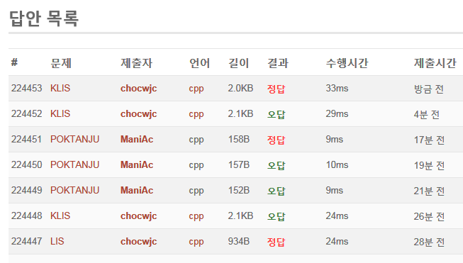
결과

